Slide 1
Bank of Baroda Hackathon 2024
Soteria
“Where Your Financial Goals Meets AI Brilliance”
Team Name : KnowWiz
Team bio :
Pranav Narkhede (Team Leader)
Keyur Mistry
Aniruddh Sengupta
Rahul Ganatra
Date : 30/6/2024

Slide 2
Problem Statement
Financial Advisory
Why did you decide to solve this Problem statement?
During our research on the Bank of Baroda website, we discovered that their investment section offers a variety of schemes and options presented in a generalized format, lacking personalization. This observation inspired us to develop an algorithm-based model that recommends the most suitable investment schemes tailored to individual users' asset allocations and future goals.
The demand for personalized financial advice is rising as customers seek tailored solutions. Traditional advisory services are costly, but advancements in generative AI and machine learning now offer reliable, sophisticated, and scalable financial advice. This creates a significant opportunity to capture market share in the growing financial advisory market, especially with increasing interest from retail investors.

Slide 3
Prerequisite
What are the alternatives/competitive products for the problem you are solving?
There are several alternatives and competitive products available for the problem we are solving. Many websites offer investment advice, but they often require human moderation or intervention, and may charge a certain amount or fee . In contrast, our solution will be an automated AI recommendation system that minimizes the need for human involvement, providing users with personalized investment recommendations based on their goals and banking history.
The other alternatives/competitive products may include:
Automated Investment Advisors
Functionality: Automated platforms that provide financial planning services with minimal human intervention. They use algorithms to create and manage a diversified portfolio based on the customer's risk tolerance and goals.
Traditional Financial Advisors
Functionality: Human advisors providing personalized financial planning and investment advice.
Hybrid Advisory Services
Functionality: Combines robo-advisory services with human financial advisors.

Slide 4
Tools or resources
Azure tools or resources which are likely to be used by you for the prototype, if your idea gets selected
Azure Machine Learning: Facilitates building, training, and deploying machine learning models to provide personalized investment recommendations.
Azure Databricks: Offers a unified analytics platform for data engineering, machine learning, and collaborative data science to process and analyze investment data.
Azure Synapse Analytics: Integrates big data and data warehousing to analyze and derive insights from vast amounts of financial data for better investment strategies.
Azure Cognitive Services: Provides AI capabilities such as natural language processing to enhance user interactions and understand user goals for investment advice.
Azure Cosmos DB: A globally distributed, multi-model database service that stores and retrieves user data and investment history with low latency.

Slide 5
Any Supporting Functional Documents
We offer an option on our banking website where users can access investment solutions. Our AI model suggests investment plans and schemes based on the user's profile, transaction history, as well as factors like preferred investment duration and amount. Additionally, our system provides an estimated percentage risk for each suggested type of investment, helping users make informed decisions tailored to their financial goals and risk tolerance.
Data Collection: We collect dummy financial data including customer profiles and transaction histories, alongside information on various government schemes and other investment options
Predictive AI Implementation: Our system employs real-time analysis of the customer database to provide tailored investment suggestions. Using machine learning algorithms trained on the collected data, it identifies suitable schemes and investment offers based on individual customer profiles, transaction patterns, and specific investment preferences.
Architecture Data Pipeline: Securely handle large-scale data ingestion and storage. ML Infrastructure: Deploy scalable cloud-based ML models.
Generative AI Module: Modular architecture for real-time advice generation. UI: Responsive interface for user interaction and data privacy compliance.
Scalability: Our project can easily be integrated in existing banking websites with an additional feature, making it easier to invest user assets effectively.

Slide 6
Key Differentiators & Adoption Plan
How is your solution better than alternatives?
Enhanced Accuracy:
Our AI model accesses real-time user banking information to provide precise and tailored investment recommendations.
Cost-Effectiveness:
Minimal implementation costs make our solution economically advantageous compared to alternatives.
Easy Implementation:
Our solution can be effortlessly incorporated into any banking website, boosting user engagement and improving overall website experience.
Personalized Engagement:
Offers personalized investment suggestions based on individual user data, promoting informed financial decisions and optimizing asset management.

Slide 7
Key Differentiators & Adoption Plan
How do you plan on building adoption?
Data Collection:
Gather a dataset of customer banking details, including personal information, transaction history, and current balance.
Collect information about all government schemes and investment opportunities, including stocks, cryptocurrencies, mutual funds, and other government or non-government options.
Model Training:
Train a predictive model based on decision-making algorithms to suggest the most beneficial and accurate investment opportunities for users.
Utilize Microsoft Azure for creating and managing the AI model.
Implementation:
Develop a dummy website and use Django to implement and test the model.

Slide 8
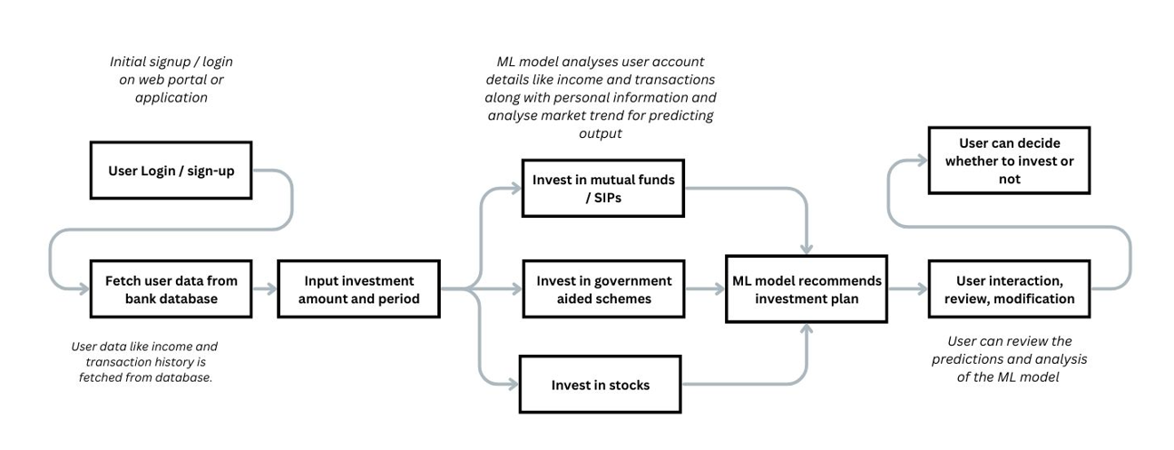
GitHub Repository Link

Slide 9
Business Potential and Relevance
What are the business applications of the problem you are solving?
1. Retail Banking and Wealth Management:
Provides personalized investment advice tailored to customers' financial goals, risk tolerance, and current market conditions.
Enhances customer satisfaction and engagement by delivering relevant and timely investment suggestions.
2.Asset Management and Investment Firms:
Offers a competitive edge with unique, automated financial planning services.
Leads to more investment opportunities and increases the number of clients through accurate, AI-driven recommendations.
3.Banking Integration:
Boosts customer satisfaction and loyalty by integrating the AI solution into existing banking services.
Provides customers with an easy to use, enhanced banking experience with personalized investment advice.
4.Future Business Potential:
Presents significant potential as a service-based product, allowing for subscription or usage-based charges.
Creates a new revenue stream and expands market opportunities by offering the AI-driven investment solution to a broader audience.

Slide 10
Uniqueness of Approach and Solution
What is the unique aspects of the proposed idea?
Personalization at Scale:
Tailors financial advice based on individual user profiles and banking history , incorporating factors such as risk tolerance, financial goals, and real-time market conditions.
Real-Time Insights and Updates:
Provides up-to-date market insights and predictive analytics, giving more accurate and useful suggestions
AI-Driven Predictive Modeling:
Utilizes advanced machine learning algorithms for predictive modeling,.
Integration with Existing Platforms:
Easily integrates with existing financial platforms, including banking apps, wealth management portals, and fintech solutions.
Security:
Seamlessly handles the crucial user information in a secure manner .

Slide 11
User Experience
How will your idea enhance the user experience?
Personalization and Relevance:
Gives recommendations that match the user's specific needs, increasing engagement and satisfaction.
Real-Time Insights and Updates:
Enables timely decision-making by offering real-time updates on investment opportunities, market shifts, and potential risks.
Accessibility and Convenience:
Simplifies complex financial concepts and strategies, making them more understandable and actionable for users of varying expertise levels.
Comprehensive Financial Planning:
Facilitates a unified approach to managing financial goals and strategies according to the users need
Integration with Existing Services:
Seamlessly integrates with existing financial platforms and tools used by users, enhancing overall usability and functionality.

Slide 12
Scalability
How effectively can your solution be scaled to accommodate growth without compromising performance?
Utilizes a cloud-based infrastructure with elastic resources to scale automatically in response to demand, ensuring consistent and accurate performance.
Adopts a modular architecture that allows each service to scale independently based on its specific workload, optimizing resource allocation and efficiency.
Implements containerization to ensure consistent and efficient deployment across different environments, facilitating seamless integration and operational stability.
Integrates an efficient performance monitoring and optimization capabilities to enable real-time adjustments and maintenance of high performance standards.
Allows testing and deployment processes to streamline updates and feature integrations, enhancing overall scalability and increase in operational agility.

Slide 13
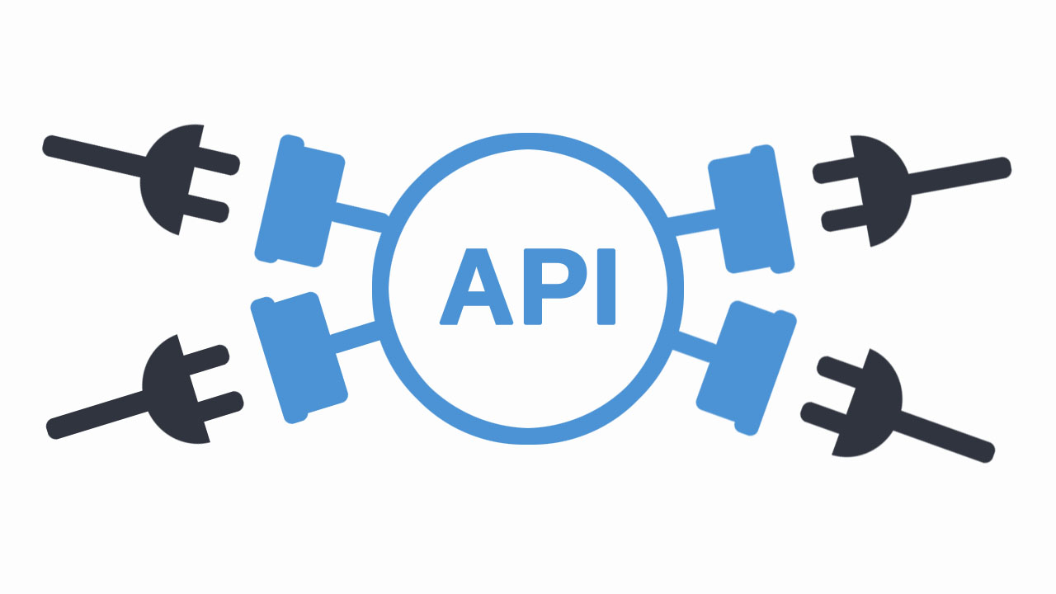
Ease of Deployment and Maintenance
How simple is your solution to implement and maintain on an ongoing basis?
Designed for simplicity in implementation and maintenance.
Simple integration into existing banking websites and mobile apps via API endpoints.
Modular approach ensures easy integration with minimal disruption to current systems.
Continuous improvement through machine learning, refining recommendations with user feedback and usage data.
Enhances user experience by delivering accurate and up-to-date recommendations.
.

Slide 14
Security Considerations
What measures are incorporated to ensure the security and integrity of your solution?
Data Encryption:
Encrypt all sensitive data both at rest and in transit to protect it from unauthorized access.
Authentication and Authorization:
Implement strong multi-factor authentication and role-based access control to ensure only authorized users have access to the system.
Secure APIs:
Use secure API gateways to manage and monitor API traffic, ensuring that only legitimate requests are processed..
User Education:
Educate users about security best practices, such as recognizing phishing attempts and using strong, unique passwords.
Secure Development Practices:
Follow secure coding standards and practices to minimize vulnerabilities in the software development lifecycle.

Slide 15
Thank You
Team member names:
Pranav Narkhede
Keyur Mistry
Aniruddh Sengupta
Rahul Ganatra

